Slide 1
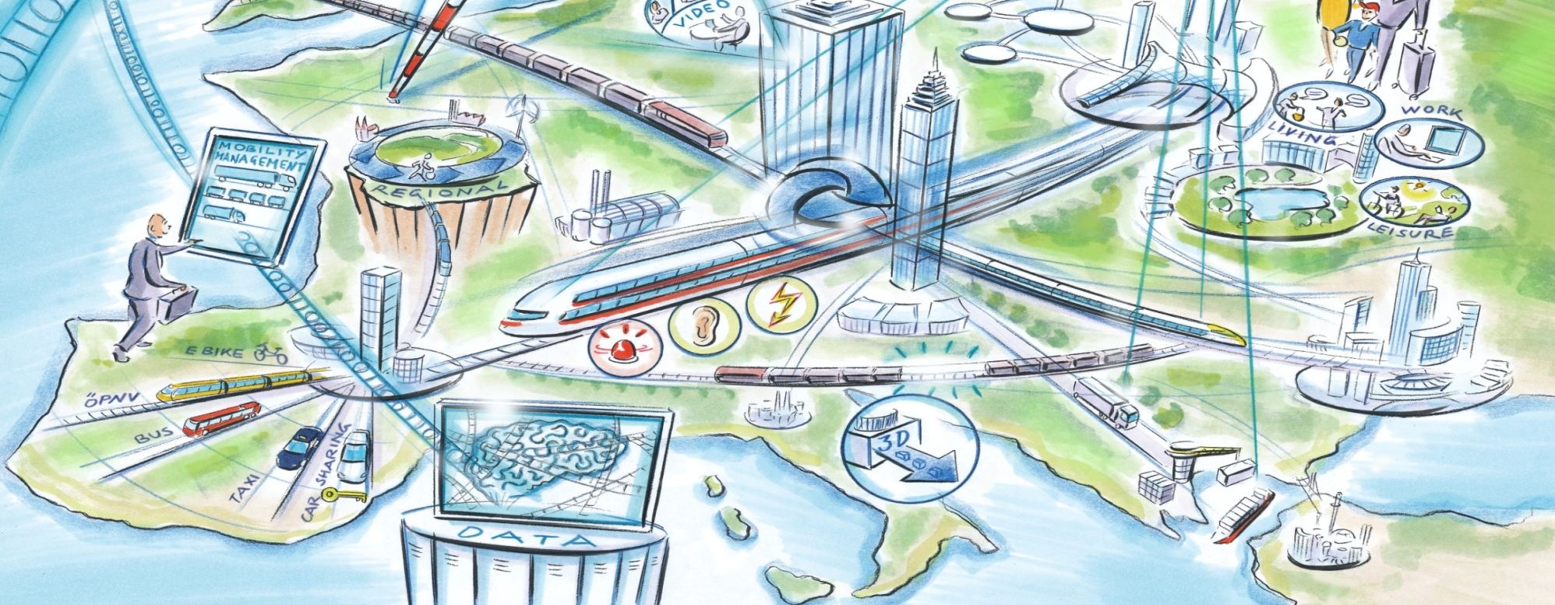
LivingRAIL: Vision Rail 2050 How Rail Contributes to a Liveable and Sustainable Europe
Claus Doll, Barcelona, 19th May 2015

Slide 2
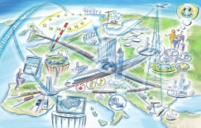
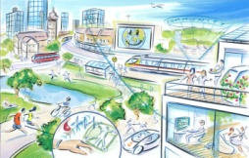
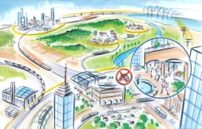
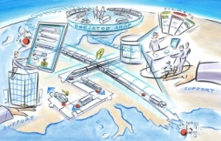

Contents
The four faces of the LivingRAIL Railmap 2050
Addressing values, lifestyles and business cultures
Designing policy, cities and spatial structures
Providing green mobility services to rail and public transport
Networks and technologies for a competitive rail system
Implementing the objectives of the EC Transport White Paper 2011:
50% of all medium distance passenger trips and
50% of medium and long distance freight
towards 2050 by rail and ship

Slide 3
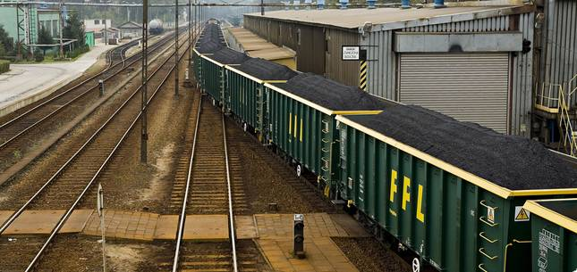
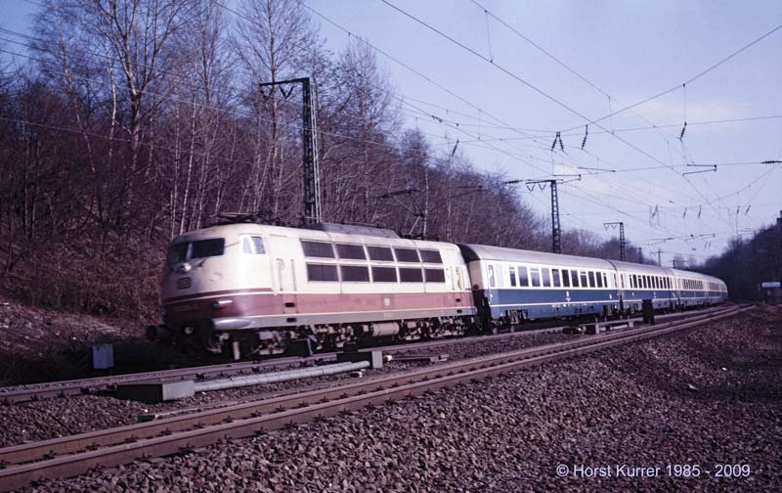
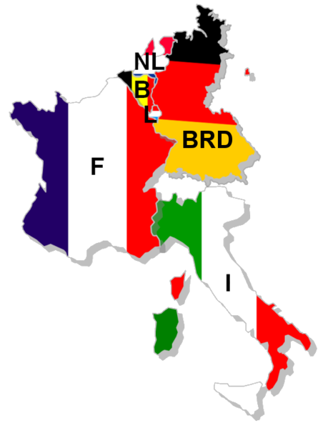
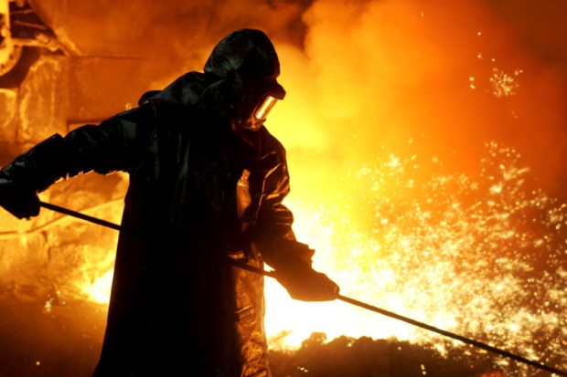
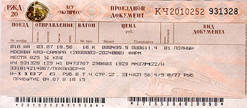
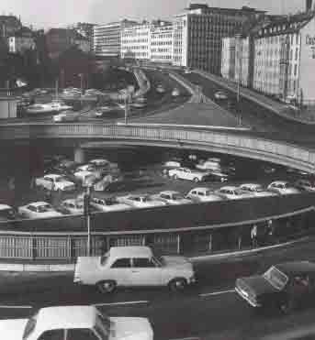
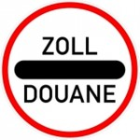
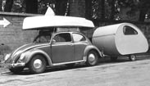
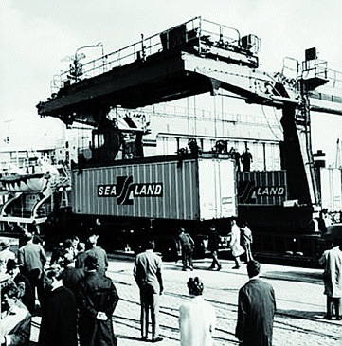
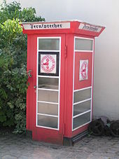
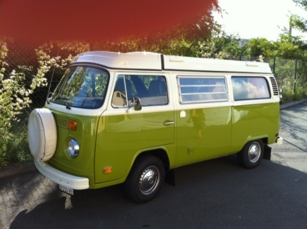
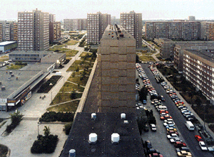
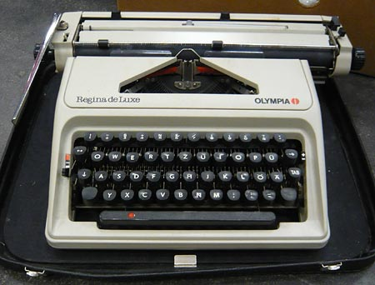
1970s
Source: freightliners.eu
Source: drehscheibe-foren.de
Source: Die Welt 17.1.2013
Source: www.buergerimstaat.de
Source: containerhandbuch.de
Source: bbsr.bund.de

Slide 4
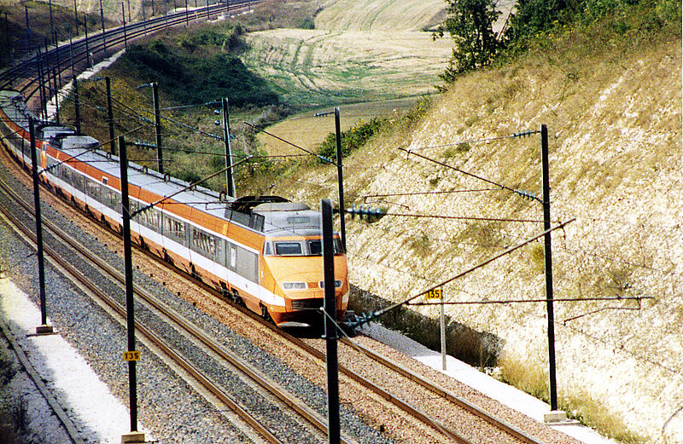
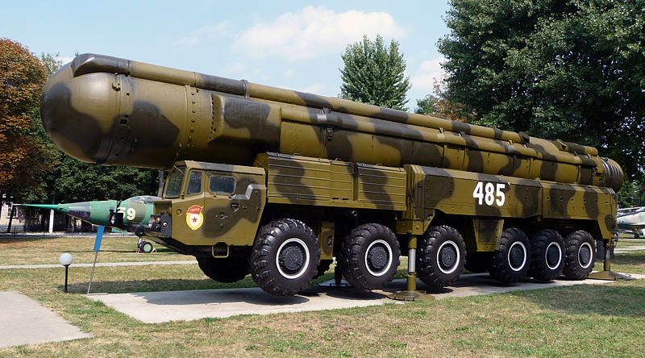
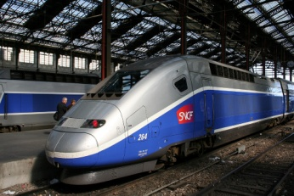
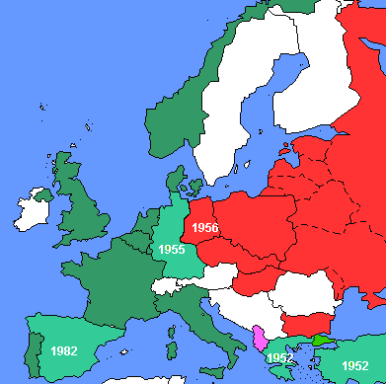

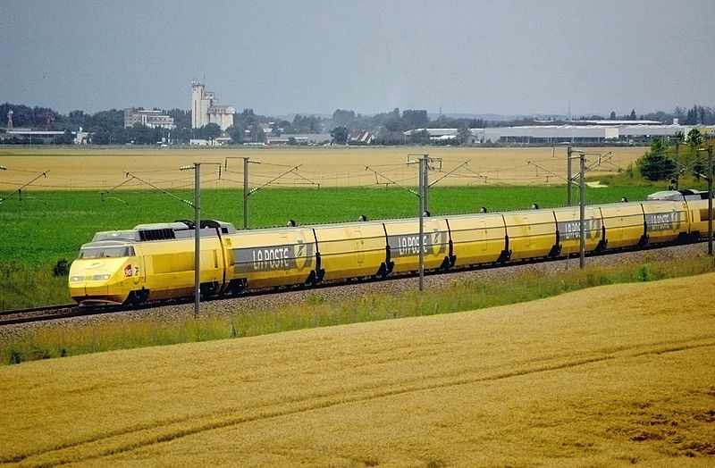
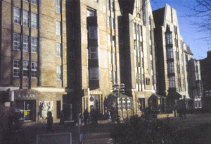
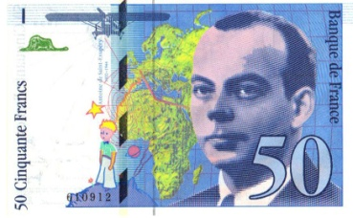
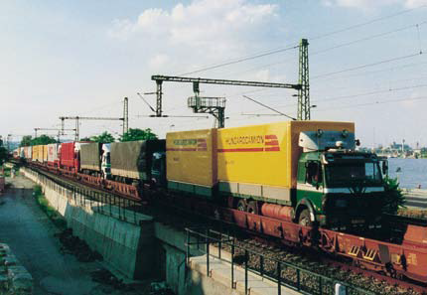

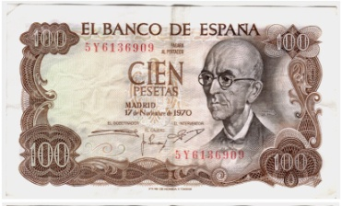
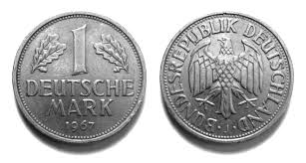
1980s
Source: wikipedia.org
Source: wikipedia.org
Source: zum.de
Source: drehscheibe-foren.de

Slide 5
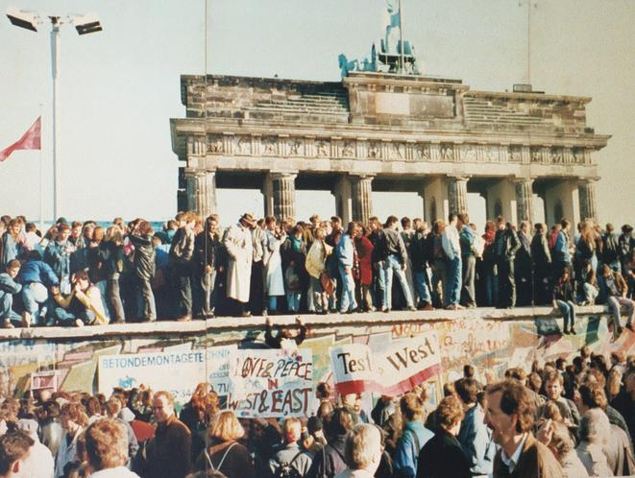
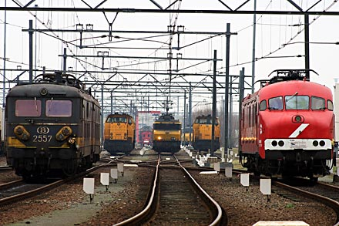
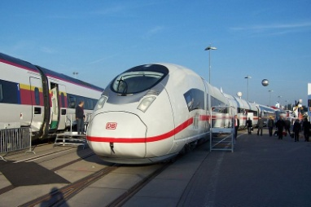
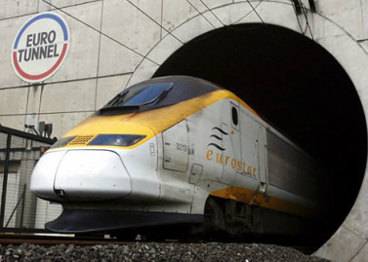

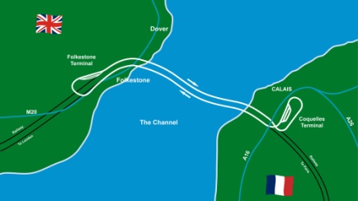
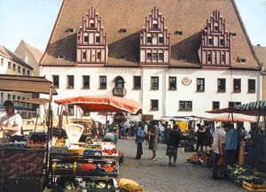
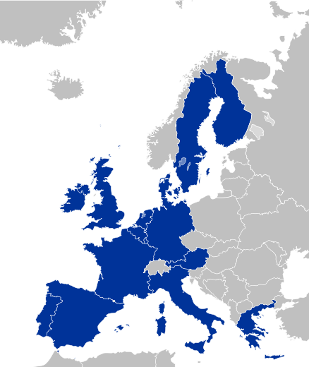
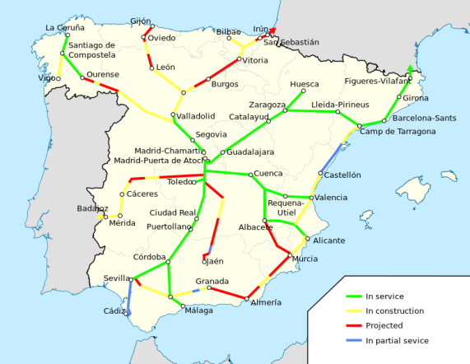
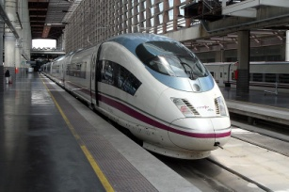
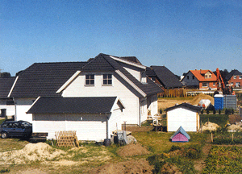
1990s
Source: derweg.org
Source: derweg.org
Source: investigatingthetravelandtourism.weebly.com
Source: drehscheibe-foren.de
Source: drehscheibe-foren.de

Slide 6
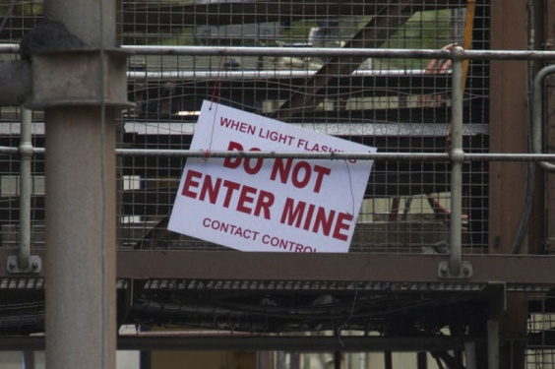

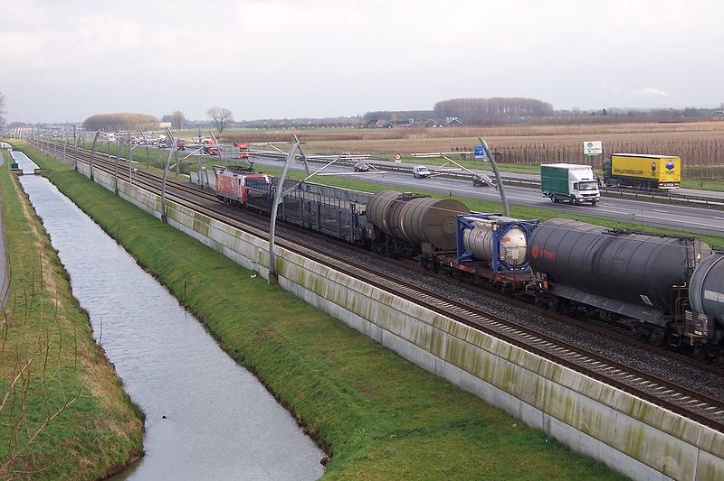

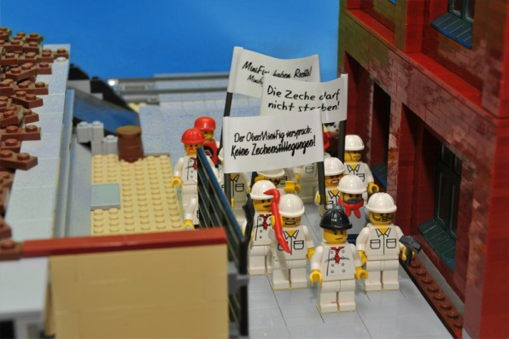
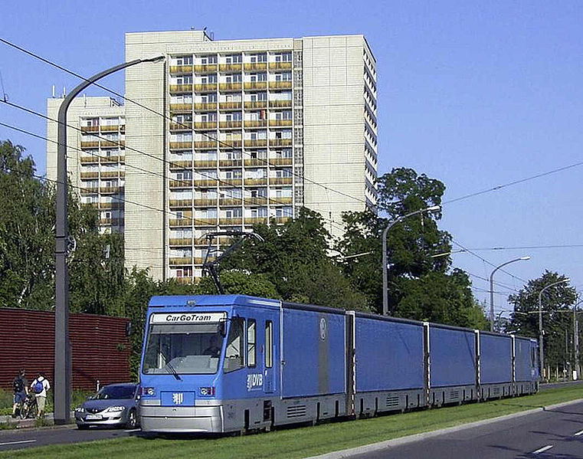
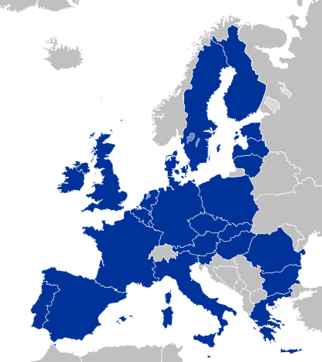

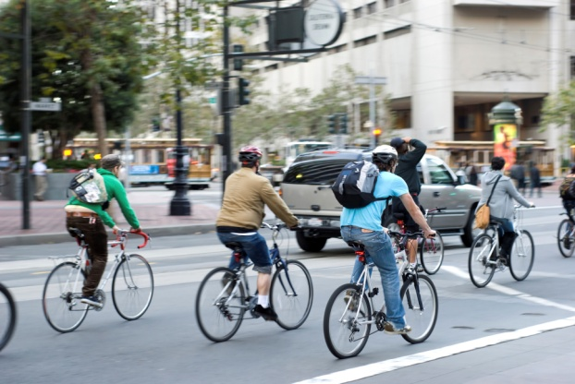

2000s
Source: wikipedia.org
Source: wikipedia.org
Source: gstatic.com
Source: wikipedia.org
Source: frantzen.de
Source: wikipedia.org

Slide 7
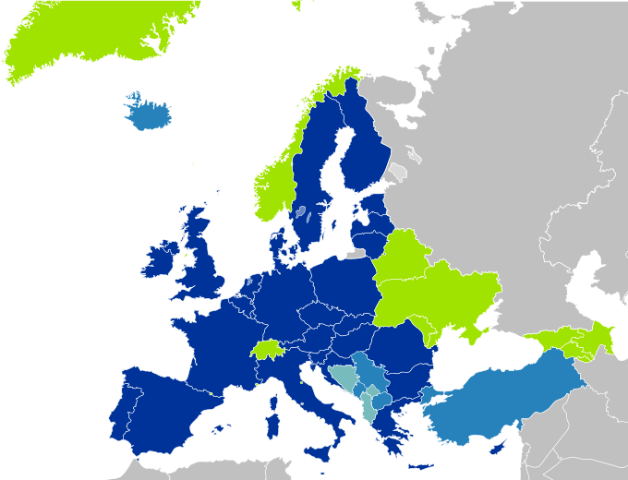
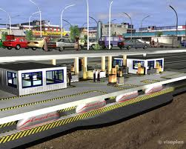
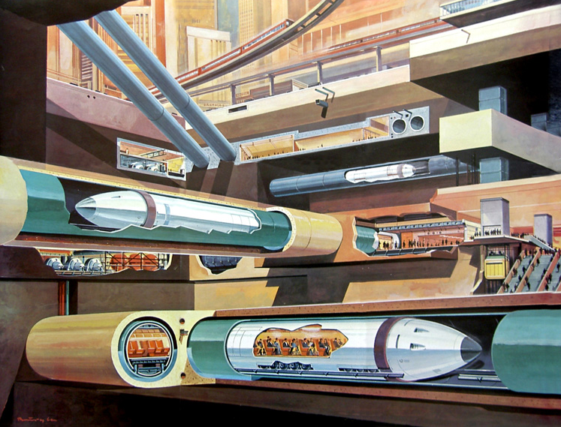
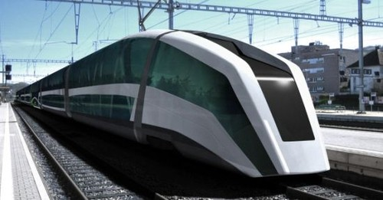
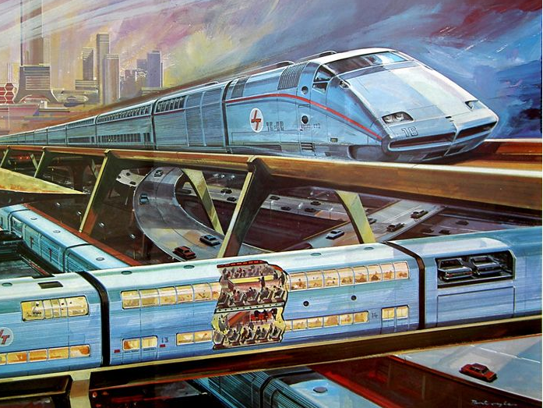
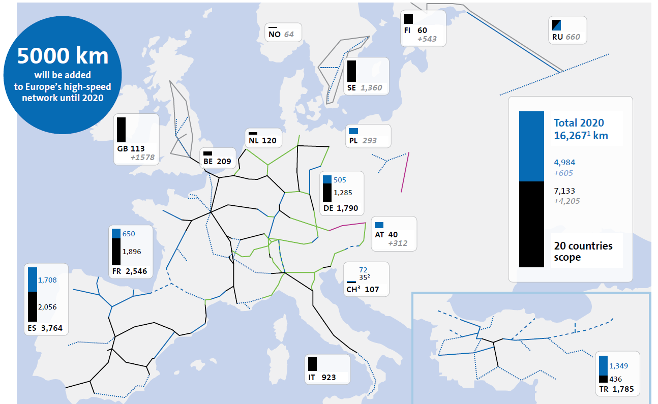

2010 beyond?
Source: wikipedia.org
Source: wikipedia.org
Source: amadeus (2013)

Slide 8

Values, lifestyles and business cultures Influencing the attitudes and the actual behaviour of travellers and companies is key for a long-term shift towards green modes

Slide 9

Life styles & business cultures Informed – sustainable - social
Today
2015
Short run
2015 – 2020
Medium run
2020 - 2030
Long run
2030 – 2050
Target
2050
Campaigns for sustainability often fail or progress slowly
They are frequently dominated by business concerns.
Sustainable behaviour & business cultures gets visible.
Work-life-balance gains increasing importance
Quality of life is element in public services & education.
Attitudes towards cars largely pragmatic.
Consistent governance show effect.
Car use dropped significantly even in low density areas.
People, companies and the public sector put high priority on sustainability, health and inclusion.
Flexibility has reduced the need for travel and car use in particular.
Mobility management in companies
Sustainable business trips
Mobility associations
Regional logistics concepts
Passenger rights in freight transprot
TOP-10-Measures
Transport Accessibility and Mobility Plans
Urban integration of rail stations
Road Pricing in cities
Car free neighbour-hoods and cities
Green and walkable cities
Rail sector & industry
Public sector and research
@
Top-10 / all sectors

Slide 10





Life styles & business cultures Promissing approaches of today
Green Cities
Copenhagen, Amsterdam and Ljubljana
Sustainable Netherlands’ A-B-C Locational Policy
Urban Congestion Charging London, Stodkholm, Milan
Car-free residential areas
Freiburg-Vauban

Slide 11

Policies for sustainable regions and cities Designing settlements, agglomerations and regions to be best served by public transport and to encourage active mobility

Slide 12
Policy, regions and cities Openn – connected - compact
Today
2015
Short run
2015 – 2020
Medium run
2020 - 2030
Long run
2030 – 2050
Target
2050
No consistent sustainability guidelines .
Low coordination between regional bodies.
Sustainability plans in place EU-wide.
Planning power to local bodies
European gateways get well connected.
Green living and mobility enforced.
Small to medium cities are fostered.
Transport, energy & ICT integrated
Europ. policy strong and coordinated
Open & competitive markets
Sustainable global logistics chains.
A consistent European to local spatial policy
Livable and well-connected cities and regions with ...
Powerful global gateways.
European network access standards
European interoperability standards
Re-vitalising regional rail stations
Re-vitalising tram & regional rail lilnes
Sustainable financing models
TOP-10-Measures
Parking management in cities
Slow zones in cities
Multi-sectoral planning authorities
Flexible public service obligations
Inclusive planning
Rail sector & industry
Public sector and research
@
Top-10 / all sectors

Slide 13



Policy, regions and cities Promissing approaches of today
Urban Regeneration linked to rail terminals
Sustainable neighborhoods in Stockholm
Lille, Vienna, Liège, Rotterdam, Sheffield, ...
Transit Oriented Development (TOD): Denver, Copenhagen, Subi/Australia, Hamburg, ...

Slide 14

Mobility Services Connecting Europe and providing access to rail and public transport while enhancing environment and quality of life

Slide 15
Mobility services Integrated – quality - Efficiency
Today
2015
Short run
2015 – 2020
Medium run
2020 - 2030
Long run
2030 – 2050
Target
2050
Bureaucratic attitude of railways
Inflexible and expensive services
Rigid / missing quality targets.
Railways monitor customer needs
Intermodal quality targets
Customer orientation
Stations get multi-modal cultural hubs
Efficient freight services / terminals
Rail user / terminal costs start falling
One-stop-shop
Multi-modal quality guarantee
Short drop of rail costs (automation & demand)
All railways are integrated mobility providers serving customer needs
Low cost, flexible and high quality door-to-door services across Europe.
On-Board Infotainment guarantee
Door-to-door logistics information
European logistics spot platform
Intermodal on-trip customer management
High service frequencies in all networks
TOP-10-Measures
Intensive market research
Intermodal quality targets
Incentives for customer orientation
Regular freight shuttles
Investment in intermodal terminals
Rail sector & industry
Public sector and research
@
Top-10 / all sectors

Slide 16




Mobiilty services Promissing approaches of today
Schöbuchbahn
Combined Rail & Car Sharing in Switzerland and Canada
Karlsruhe Tram-train
Seamless air-rail-travel from and to Frankfurt airport

Slide 17

Rail Systems: Technology and Organisation Dense networks and automated services allow enormous demand shifts to rail with high quality and low costs

Slide 18
Rail technology & organisation Networks – Vehicles - Operations
Today
2015
Short run
2015 – 2020
Medium run
2020 - 2030
Long run
2030 – 2050
Target
2050
Dropping regional connections
Slow HSR extension
Multiple technical standards
Start separation of networks
Standardised ICT protocols
Extension of passenger rights
Extension fast intercity links
Standardised signalling system
All major cities connected to HSR
Electrification and closure of gaps
Moving-Block-Systeme installed
Rapid innovation in rail industry
Fast and reliable connections with 2–4-fold capacity across Europe
High innovation potential and efficiency of rail industry due to demand growth
Simplified technical standards
Standards for longer and wider trains
Rapid retrofitting of rolling stock
Standard for moving blocks (ECTS level 3)
Automated trains & terminals
TOP-10-Measures
Extension of inter-city network
Gap closure in the European networks
High capacity freight networks
Complete European HSR network
Networks for longer / wider trains
Rail sector & industry
Public sector and research
@
Top-10 / all sectors

Slide 19



Rail technology & organisation Promissing approaches of today
Always Informed Passengers on SmartPhones
High speed networks
DB Train Lab in Magdeburg

Slide 20

Railmap towards 2050 Immediate action and continuous efforts are needed to generate and maintaina a broad and sustainable interest in rail based mobility services

Slide 21
Affordability and Effectiveness Landscape

Slide 22
Railmap Impact Assessment Drivers and results by the ASTRA model
Transport impacts
Measures related to qualitative aspects (reliability, comfort, integrated services,…) and behaviour are crucial
Cost and speed changes are not sufficient to achieve 50% rail share
38%
of total
demand
39%
of total
demand
35%
of total
demand
Sustainability assessment
Cost (and speed) changes provide some positive effects on externalities
BUT: if the target share is met, energy consumption, emissions and road accidents can be significantly cut
-25%
-40%
-45%
-80%

Slide 23


Some final recommendations for EU and Spain
For all European countries and regions:
Railway and policy reforms: Place users in the core of decision processes
Integrated services: Railways to offer and promote door-to-door mobility and logistics solutions in both high and low density European regions
Policy co-operation: Apply coordinated spatial, urban and transport planning
Networks: Closte cross-border links and provide high capacity freight corridors
Timing: Immediate and continuous action is needed for visible & sustainable effects
For peripheral and low density areas:
Flexibility and reliability: Foster intermodality in passenger and freight transport chains including powerful access services.
Acceptance and accessibility: Re-design passenger rail stations to commercial and cultural centres with extended services
Services: provide high quality connections to European centres

Slide 24

Some final recommendations for EU and Croatia
For all European countries and regions:
Railway and policy reforms: Place users in the core of decision processes
Integrated services: Railways to offer and promote door-to-door mobility and logistics solutions in both high and low density European regions
Policy co-operation: Apply coordinated spatial, urban and transport planning
Networks: Closte cross-border links and provide high capacity freight corridors
Timing: Immediate and continuous action is needed for visible & sustainable effects
For peripheral and low density areas:
Flexibility and reliability: Foster intermodality in passenger and freight transport chains including powerful access services.
Acceptance and accessibility: Re-design passenger rail stations to commercial and cultural centres with extended services
Services: provide high and good medium speed schedules to European centres

Slide 25










Thank You !
Co-funded by the Seventh Framework Programme of the European Union.
More information and documents at: www.livingrail.eu
Project co-ordinator: Dr. Claus Doll
Fraunhofer-Institut für System- und Innovationsforschung (ISI)
Breslauer Str. 48, D-76139 Karlsruhe
Tel.: +49 721 6809-354, Fax: +49 721 6809-135
E-Mail: claus.doll@isi.fraunhofer.de

Slide 26
Backup

Slide 27
Mobility Services Examples for 2050 measures
Urban Car Pricing
Curbing car use in residential areas and raising funds for advanced and affordable public transport and mobility services for all.
Road pricing is implemented in all cities from differen-tiated charging systems in agglomerations to parking pricing in smaller towns.
Agglomeration
Small Cities
Modal shift
potential [%]
20 %
20 %
20 %
15 %
15 %
15 %
short run
(2015 – 20)
medium run
(2020 – 30)
long run
(2030 – 50)
Major revenues will support urban PT development, but the full implementation of sufficient pricing schemes takes time.
1,39
Source: http://tollroadsnews.com/news/
stockholm-central-area-toll-restart-to-be-camera-based
IMPACT - SCORE

Slide 28
Railmap towards 2050 Top-25 measure by time line
Freight network design
European HSR network
Activities for the transport sector and industries
Networks
Stations & terminals
Rolling stock
Service
Rail reform
Activities for public administration and user communities
Funding
Regulation
Planning
Mobility management
Cities & regions
Regular freight shuttles
High service frequencies
Close network gaps
Incentives for customer orientation
Networks for longer / wider trains
Rolling stock modernisation
Public service obligations
Passenger stations to urban centres
European logistics brokerage platforms
Green and walkable cities
Sustainable funding schemes
Door-to-door logistics management systems
Inclusive planning
Mobility management
for employers
Urban car pricing
Intermodal freight facilities
Re-vitalise rail stations
Mobility associations
On-trip internet access
Mobility & accessibility plans
European track access standards
Upgrade intercity rail lines
European interoperability standards

Slide 29
Railmap towards 2050 Feasibility of measures
The LivingRAIL Railmap

Slide 30
Mobility Services Promising practices today

Slide 31

Mobility Services Examples for 2050 measures
Rail liberalisation
Provide incentives to move railways and policy players more towards market and customer orientation
Providing incentives and regulations for making railways competitive under market conditions.
Agglomeration
Small Cities
20 %
Modal shift
potential [%]
10 %
10 %
5%
5%
short run
(2015 – 20)
medium run
(2020 – 30)
long run
(2030 – 50)
All European regions are subject to these reforms with an expected increase of rail demand by 5% to 20% by 2050 with higher impacts on large agglomerations and dense areas.
2,07
IMPACT - SCORE

Slide 32

Policy, regions & cities Example measures for 2050
Transport Management &
Accessibility Plans (TMAP)
Making a good accessibility of commercial and administrative facilities by rail and public transport compulsory to reduce car dependency.
The purpose of the Transport Management and Accessibility Plan (TMAP) process is to formulate a package of policy, service and infrastructure measures to meet the requirements of the subject site development.
Agglomeration
30 %
Small Cities
Modal shift
potential [%]
15 %
10 %
3 %
2 %
5%
short run
(2015 – 20)
medium run
(2020 – 30)
long run
(2030 – 50)
With including all major companies, employers, etc. we might even see some spill-over effects to long distance rail travel.
1,22
IMPACT - SCORE

Slide 33

Values & lifestyles Example measures for 2050
Green cities
Change peoples’ and with that companies’ lifestyles and appearance by offering inspiring environments
Mobility Management for Employers compulsory
Change peoples’ and with that companies’ lifestyles and appearance by offering inspiring environments
Applicable to 50 to 100 % of European cities and regions
Raising rail and PT demand by 15 to 30 %
Applicable to 30 to 60 % of European cities
Raising PT shares by 8 to 10 %

Slide 34
Railmap towards 2050 Feasibility of measures - Policy
The LivingRAIL Railmap
Landscape of Measures by
Effectiveness and Affordability
Part: Policy, Regional and Urban Measures

Slide 35

The LivingRAIL Railmap
Landscape of Measures by
Effectiveness and Affordability
Part: Policy, Regional and Urban Measures

Slide 36
Mobility Services The science base
Number of car sharing users in Germany since 2001 by type of service
Source: Bundesverband Carsharing e.V. (2014)
Transport modes and services impact each other
Available multi-modal services plus novel ICT tools make the switch to modes ever more attractive and easy.
Car- and bike sharing users need public transport as a backbone solution
High urban PT shares imply high rail use for long distance
Funding of new mobility solutions via increased PT and rail fares is possible
BUT: price of rail and alternatives plays a vital role in mode choice decisions!
Regression of long distance rail shares (target connections per city)over commuter PT shares.
Data sources: SIEMENS green city index , Eurostat.
Compilation: Fraunhofer ISI

Slide 37
Mobility Services The Strategy to 2050
Foster Multi-Modality
Rail and public transport need multi-modal integration to maximise flexibility
Develop rail stations to become intermodal hubs
Support regional mobility associations linking multiple service providers.
Reforming Railways
Rail carriers and policy seem to be satisfied with small to medium-sized market niches.
Railways to undertake intensive customer market studies in the short run.
Define and keep binding performance targets in all market segments
Funding the mobility shift
In the long term revenues from a massive mode shift will outweigh initial investment costs.
Cross-subsidise sustainable transport modes through appropriate mobility pricing.
Combine private capital for high demand corridors with PSOs in remote areas

Slide 38

Policy, regions & cities The science basis
Spatial structures matter for rail share:
Concentration of population
Polycentric countries & regions
Dense cities stimulate public transport
Giving back urban space to non-car-related activities encourages PT use, cycling & walking
Soft factors are relevant
Over half of users are pragmatic concerning mode choice
Changes are most likely in breaks of life phases
Soft factors make up 50% of mode selection criteria after costs, time and reliability
Urban sprawl
and car use
intensity: spatial
structures matter

Slide 39
Policy, regions & cities The Strategy to 2050
Strengthen the power of local communities
Small and medium sized centres support rail while offering good quality of life
Strengthen the power of local communities
Re-vitalise small and medium sized railway stations
Implement regional freight solutions
Bundling logistics flows help the railways to re-gain lost market segments:
Carefully analyse failures of urban logistics centres in the past
Provide financial incentives for companies to locate near rail facilities
Open and inclusive European transport planning
Prevailing inconsistent and confusing policy goals and instruments need to be reviewed
Create a common European rail and mobility vision and roadmap
Co-ordinate European and national plans with active participation of the railways

Slide 40

Values & lifestyles The science basis
Car ownership declining for generation-Y
Behaviour changes:
Generation Y and reduced car ownership
Impacts: income, education & alternatives.
Changes with education, income, social group
Change most likely in break in life phases
Travel mode choice
Just one of several expressions of lifestyle
Only partly depend on hard factors (time & costs).
Soft factors up to 50% of decisions
Perception of soft factors influenced by culture, income, education and system knowledge
USEmobility: non-captive users are dominant

Slide 41
Values & lifestyles The Strategy to 2050
Information and regulation
For the decades ahead we expect people, companies and the public sector to put a high priority on sustainability, health and inclusion in decisions across all parts of society.
Actively address social norms and values with campaigning techniques, etc.
Stimulate green behaviour by information, incentives and regulation.
Stimulating environments and services
Creating and sustaining the envisaged shift in preferences requires the constant application and adjustment of a bundle of push and pull instruments.
Foster the transition towards green and transit friendly cities.
Implement transit oriented development in all cities and regions
Improve the attractiveness, accessibility and cultural function of rail stations

Slide 42
Railmap impact assessment Exercise with the ASTRA-EC model
ASTRA model: system dynamics based strategic assessment tool:
Mostly country level (some variables NUTS I or NUTS II).
“Aggregated” transport modes: “Rail” include everything from metro to HST
Abstracting from transport network (stations, interchanges, track capacity…)
Three scenarios:
Cost change Speed change Target rail shares
Mode | Cost change |  | Mode | Speed change |  | Context | Target share
Rail | -20% / -40% |  | Rail | +15% / +20% |  | Pass – urban | 45% - 60%
Road | +5% / +15% |  |  |  |  | Pass – interurban | 35% - 70%
Air | +50% / +60% |  |  |  |  | Freight | 40% - 60%
Maritime | +15%
Average of new high speed and fast freight services within overall rail traffic market

