Slide 1
Funding opportunities of integrated public transport – approaches from Germany
Key-note speech at the croatian pro-rail alliance conference "Public passenger transport in role of Regional Development"
Zagreb, 26 March 2015

Slide 2
Agenda
Funding structures of German PT at a glance
Introducing BSL Transportation
Funding of public transport in Germany
Questions and panel discussion
Our team, portfolio and references (excerpt)
Joint discussion and / or bilateral talks

Slide 3
Agenda
Introducing BSL Transportation
Funding of public transport in Germany
Questions and panel discussion

Slide 4
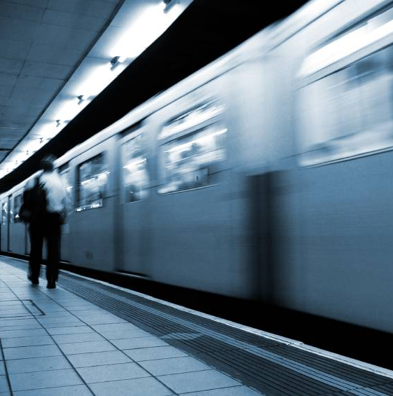
BSL Transportation is a consultancy specialised on the Transportation and Logistics sectors with a focus on Public Transport
Profile
Founded in 2010 as a spin-off of the market leading (public) transport consultancy in Germany
Four partners with more than 50 years of experience in consultancy
Highly experienced and senior team
In-depth market knowledge and comprehensive methodological expertise
Strongly committed to quality and innovation
Holistic approach ranging from strategy develop- ment to operational process reengineering
Partner of top and senior management of our clients
Source: BSL Transportation Consultants

Slide 5
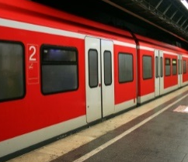
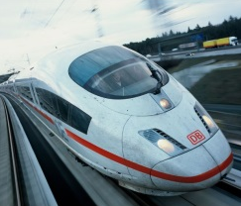
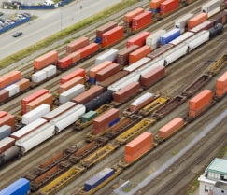
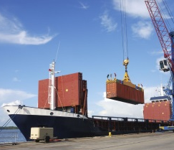
Our approach enables us to comprehensively and efficiently support all market players
BSL’s approach and business areas
Specialised: As experts in various business areas, we focus on and have accumulated profound knowledge of the markets, stakeholders and processes
Innovative: We continuously strive to develop new consulting instruments and methods and to improve existing ones
Interdisciplinary: We provide full service from strategic consulting to implementation consulting at operational and technical level
Cooperative: We are operating in a broad network
International: We provide support to clients all over the world
Transport
Short Distance Passenger Transport
(Heavy) Railways
Rail Cargo
Logistics
Source: BSL Transportation Consultants
Notes:
Fotos – Verkehr: ? Ver- und Entsorgung: 1-3: Fotolia; 4: Imagebroschüre

Slide 6







BSL Transportation offers a wide consulting portfolio – focus of today‘s presentation is organisational concepts and marketing and sales
CONSULTING PORTFOLIO
FOCUS
Organisational concepts
Benchmarking/target costing
Strategic concepts
Operational and organisational structure
Change management
Funding and financing
Cost / productivity analysis
Target costing
Analysis of wage level agreements
...
Market entry / bid support
Restructuring process
Innovation and technology management
…
Process analysis
IT-Support
Asset Management
Operations
Maintenance
Overhead
Sales
…
IT-Strategy
Process optimisation using tools like Depot Manage-ment Systems, ICTS etc.
…
Procurement planning
Investment and maintenance mgmt.
...
FOCUS
Marketing and sales
M&A
Controlling/management tools
Customer surveys
Ticketing and fare systems
Revenue sharing agreements
Balanced score cards
Quality management
Controlling concepts
...

Slide 7
Agenda
Introducing BSL Transportation
Funding of public transport in Germany
Questions and panel discussion

Slide 8
Benchmarks between european cities show that fare revenues only cover part of the financial needs of public transportation
International Funding structures
Other revenues
Fees (Versement Transport)
Public funding
Fare revenues
Berlin
Barcelona
Madrid
Amsterdam
Paris
Brüssel
Source: Friedrich-Ebert-Stiftung

Slide 9
In Germany fare revenues on average only cover 37% of the total public transport costs – high operational subsidies needed
German funding structure (1/2)
Revenue structure public transport in Germany (bn EUR)
24.6
2.2
10.7
2.7
2.7
6.3
9.0
4.0
2.3
Total costs
Tarif loss compensations
Other subsidies
Other revenue (advertising, etc.)
Fare revenues
ex TA -Fare revenues
TA Fare revenues
Thereof season tickets
Pay by ride
Source: BSL Transportation Consultants Research

Slide 10
Germany has a complex funding system, however, the regionalisation funds are an efficient financial instrument to assure operations
German funding structure (2/2)
Simplified
FEDERAL GOVERNMENT
Regionalisation funds
Regionalisation funds
Municipality transport financing
Other financial instruments
FEDERAL STATES
Public transport allocation
Infrastructure
Contracts
MUNICIPAL LEVEL
MUNICIPAL OWNERS
School traffic
Contracts
Funding of transport association
Deficit financing
RAILWAY COMPANIES
BUS COMPANIES
Fare revenues
PASSENGERS
Source: Friedrich-Ebert-Stiftung (2010)

Slide 11
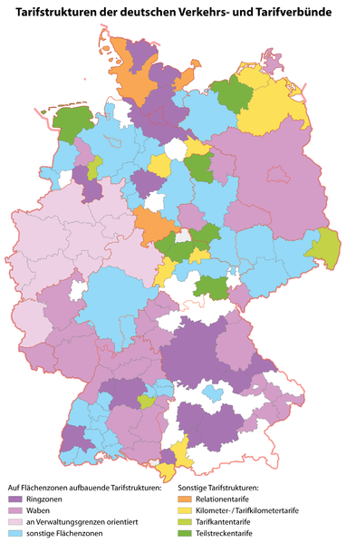
In Germany transport companies joined to 40 transport associations¹ (“Verkehrsverbünde”) which account for 70% of total fare revenues
Transport associations in GErmany
6,295
36
Verkehrsverbund Hegau-Bodensee
TA tariffs
69
63
Karlsruher Verkehrsverbund
Verkehrsverbund Oberelbe
174
150
….
228
204
Verkehrsverbund Bremen/ Niedersachsen
Mitteldeutscher Verkehrsverbund
Großraum-Verkehr Hannover
30%
70%
Verkehrsverbudn Großraum Nürnberg
Verkehrsverbund Rhein-Neckar
Verkehrs- und Tarifverbund Stuttgart
Verkehrsverbund Rhein-Sieg
Hamburger Verkehrsverbund
Münchener Verkerhs- und Tarifverbund
Company tariffs²⁾
Rhein-Main-Verkehrsverbund
Verkehrsverbund Rhein-Ruhr
Verkehrsverbund Berlin-Brandenburg
Revenues (m€)
N=40; in addition, there are more than 20 tariff associations
Mainly consisting of Deutsche Bahn AG
Source: BSL Transportation Consultants Research

Slide 12
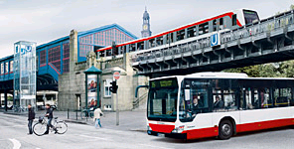
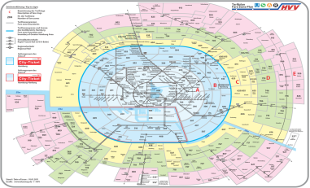
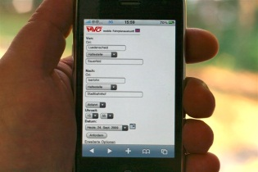
The main reason for transport companies to work jointly in transport associations is the increase of their total fare revenues
Characteristics of an integrated network
Transport offer
Fare system
Sales system
Communication
BUS UND ZUG
Joint traffic planning
Timetable coordination (connection assurance)
Constructional aspects and infrastructure (e.g. stations)
Integrated fare system for using bus and rail in common
Travel distance determines price instead of the change of the traffic carrier
One ticket valid for both, bus and rail
Shared ticket sale by all associated transport companies
Same distribution technology
Joint marketing of the provided transport offer
Common time-table information and enquiry management
Marketing of targets instead of companies
Revenue sharing agreements
Source: BSL Transportation Consultants Research

Slide 13
Three financial impacts are linked to the foundation of transport associations
Financial effects of transport associations
Increased traffic
Mehrverkehr
Significant increase in passenger numbers and fare revenues
Improved transport offer and joint marketing leads to significant passenger growth
Positive effects resulting from passenger increase usually clearly exceed tariff losses and administrative costs
Tariff losses
The price of two separate tickets (e.g. bus and train) exceeds the price of one combined ticket for the same route length
Losses due to accociation tariffs can be calculated exactely and does not have to be that high
Administrative costs
Costs occur for the implementation of transport associations e.g. for personnel and marketing
In Germany administrative costs amount to approx. 2-4 percent of the yearly fare revenues of transport associations
Source: BSL Transportation Consultants Research

Slide 14
We provide extensive know-how in the area of developing integrated public transport…
CREDENTIALS¹
LNVG, Hannover
Realisation of a state-wide fare system for rail and bus
Implementation of a revenue sharing system
LVS, Kiel
Realisation of a state-wide fare system for rail and bus
Implementation of a revenue sharing system
VRT (Trier), VSN (Göttingen)
Realisation of integrated transport systems
Development of fare systems and revenue sharing systems
Berliner Verkehrsbetriebe
Development of a market strategy
Action plan for fare system and sales system
Deutsche Bahn, Frankfurt
Design of a nationwide transport association
Study for the future organisation of the association
HHA (Hamburg), SWM (München), IFTEC (Leipzig)
Analysis of the ticket distribution technology
Costs, productivity, quality and revenues
LVS: Landesweiten Verkehrsservice Gesellschaft, VRT: Verkehrsverbund Region Trier, VSN: Verkehrsverbund Südniedersachsen, HHA: Hamburger Hochbahn, SWM: Stadtwerke München, LNVG: Landesnahverkehrsgesellschaft Niedersachsen

Slide 15
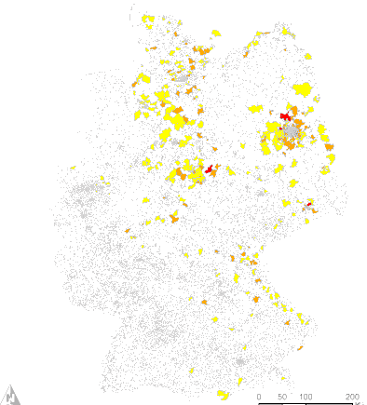
… and are able to support our clients from the strategic planning of an integrated public transport system until the implementation process
EXAMPLES
international benchmarks of fare systems
GIS-based market analysis
Optimisation models for fare system
Introduction of new sales system

Slide 16
Agenda
Introducing BSL Transportation
Funding of public transport in Germany
Questions and panel discussion

